Slide 1
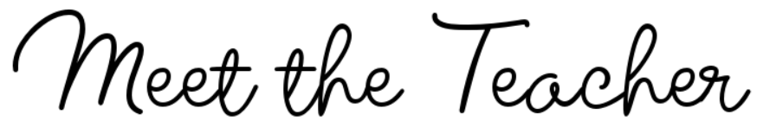


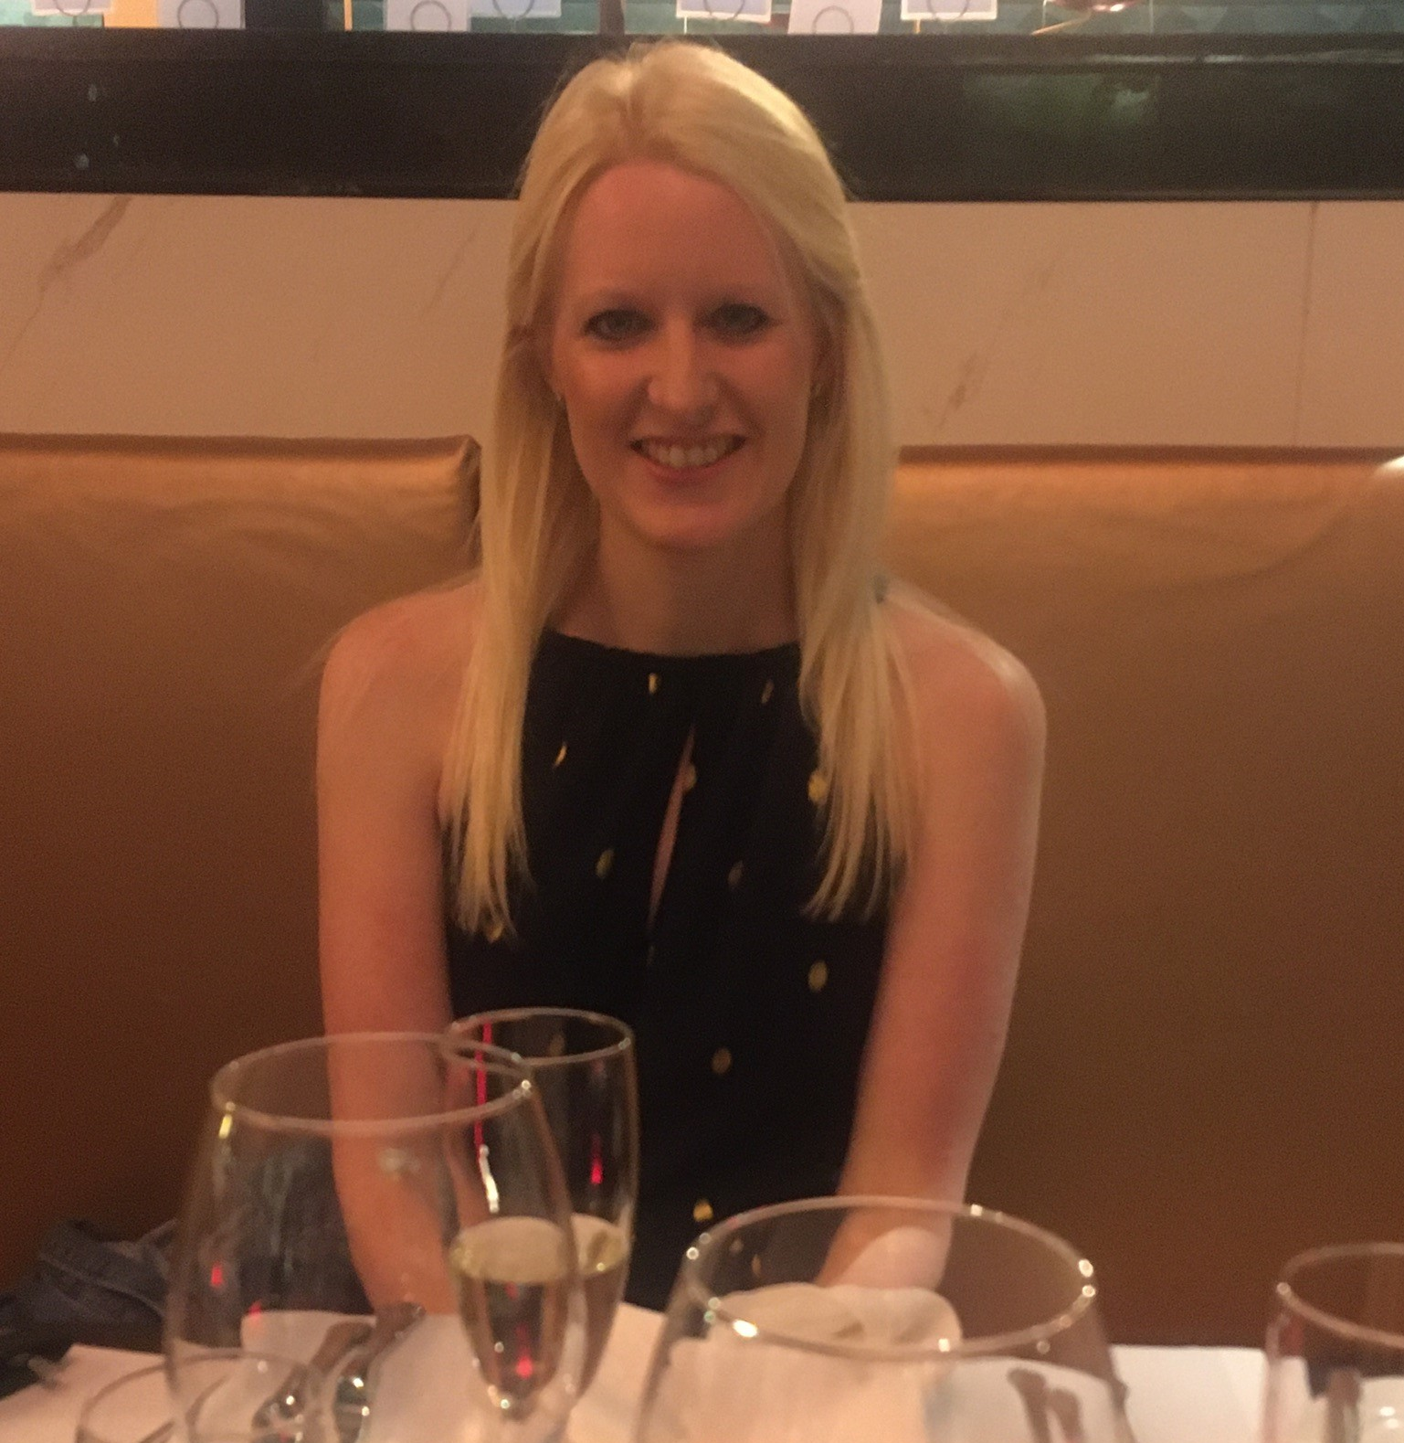

I spend a lot of my spare time seeing my family and friends. I have a daughter called Isabelle who is nearly two and she keeps me very busy! We love visiting farm parks, playgrounds and ice cream farms.
When I have a moment to myself, I love to read. I particularly love reading before I go to sleep, snuggled up under my duvet. Over the summer holiday, I managed to read three books and I’m hoping to continue reading lots once we are back at school.
Another of my interests is visiting National Trust sites. I love history; I find it really interesting to discover how people lived in the past. One of my favourite places to visit is Tatton Park. It’s actually where my husband proposed to me!
Hobbies and Interests…
Welcome to Chestnut Class!
It is my sixteenth year of teaching and I have taught at Peover for over eight years. I am the Maths and Science Lead. I also really passionate about Computing; I love using technology to enrich children’s learning in the classroom. Another of my responsibilities is the Key Stage Two Lead.
I can’t wait to start a new school year in September. Each year is like a new chapter of a book – exciting and one great big adventure!
Welcome
Mrs Blackham –
Chestnut Class
My favourite children’s book is Wonder by R J Palacio. I absolutely love how it encourages people to be kind because I feel that is the best thing anyone can be! When I read it for the first time, I sobbed my way through many of the chapters! IT IS A MUST READ! ☺
My Favourite
children’s book and why…
We ask that parents and carers contact class teachers as the first point of call for any questions, concerns or updates relating to their child. This helps to ensure that any issues can be addressed promptly and consistently by the person who works most closely with your child
between the hours of 8am and 5:30pm
You are always welcome to come and speak to me at the end of the school day when collecting your child. Alternatively, if you would prefer to email me or arrange a meeting, you can email Janet: admin@peoversuperior.cheshire.sch.uk who will pass on your message.
INSERT PHOTO
Contact Information

Slide 2




From September, homework will be sent out each week via email by the class teacher. It will follow a consistent layout across the school to help children and families know what to expect and to support a clear routine at home. This method will enable families to access homework easily, stay informed about weekly tasks, and support children’s learning more effectively. Homework will reinforce key skills taught in class and provide opportunities for children practice and consolidate their learning.
Homework
As a school, we have high expectations for behaviour and expect all of our children to show kindness, respect, and responsibility in all they do. To support this, we will be introducing Class Dojo in September—a positive behaviour system that allows children to earn points for good choices and helps us celebrate their efforts. Class Dojo also provides a way for school and home to stay connected and share progress.
Behaviour
At Peover Superior, we are committed to
ensuring every child receives an excellent education, and
consistent attendance is fundamental to achieving this. Regular attendance directly supports academic progress, fosters crucial social and emotional development, and cultivates positive learning habits. By working together – pupils, parents, and staff – to achieve our attendance target of 96%, we create a stable and supportive learning environment that promotes uninterrupted learning, strengthens relationships, and enhances each child's sense of belonging within our school community.
From September, our gates will open each morning at 8;45am and will close at 8:55am to ensure that ALL children are in their classrooms and at their desks to start learning at 9am – Every minute counts!
Healthy Habits at School
It’s important that all children bring a named water bottle to school each day to help them stay hydrated and focused throughout their learning. Please also ensure that breaktime snacks and lunchboxes contain healthy options, such as fruit, vegetables, wholegrain items, and low-sugar choices. Supporting your child in making healthy food and drink choices helps them feel their best and do their best every day at school.
Water bottles and Snacks
PE days for our class will be on Tuesdays and Fridays. Children are required to come to school wearing their full Peover PE kit in school colours only—this means no branded sports logos or non-uniform items. Wearing the correct kit ensures children are safe, comfortable, and ready to take part in all PE activities while continuing to represent our school with pride.
PE Days

