Slide 1
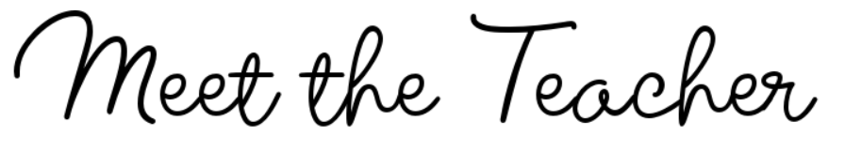


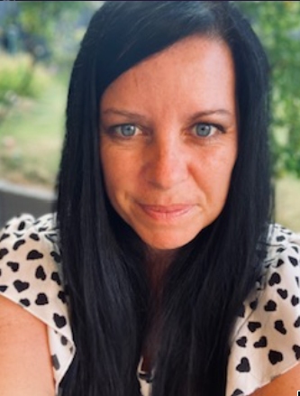
Outside of the classroom, I love spending time with my family and our little dog, Mimi. We enjoy going on day trips, holidays, and exploring new places together. Since September 2024, I’ve taken up daily running and have even completed several 10k events around Cheshire. I also enjoy swimming, reading, and going on bike rides—anything that gets me moving or lets me unwind with a good book!
Hobbies and Interests…
Welcome to Sycamore Class!
I’m so excited to welcome you all to our new class and to the start of a fantastic year ahead! We have lots of exciting learning, challenges, and opportunities planned, and I can’t wait to get to know each and every one of you. This year, we’ll be working together to build a positive, supportive classroom where everyone feels valued, confident, and ready to do their best. I’m really looking forward to the journey we’ll share together—let’s make it a great year!
Welcome
Mrs Munro – Sycamore Class
As many of the children at Peover already know, I'm a Headteacher who just loves to read! My office is full of wonderful children's books, and I always enjoy sharing them with others. One of my all-time favourites is Harry Potter—I never get tired of the magic, adventure, and friendship in those stories. Children are ALWAYS welcome to pop into my office, have a browse through the book selection, and borrow one to enjoy at home or during quiet reading time.
My Favourite
children’s book and why…
We ask that parents and carers contact class teachers as the first point of call for any questions, concerns, or updates relating to their child. This helps to ensure that any issues can be addressed promptly and consistently by the person who works most closely with your child
between the hours of 8am and 5:30pm
You can contact me directly via email head@peoversuperior.cheshire.sch.uk or, if you would prefer to arrange a meeting, bookings can be made through Janet by emailing admin@peoversuperior.cheshire.sch.uk.
Contact Information

Slide 2




From September, homework will be sent out each week via email by the class teacher. It will follow a consistent layout across the school to help children and families know what to expect and to support a clear routine at home. This method will enable families to access homework easily, stay informed about weekly tasks, and support children’s learning more effectively. Homework will reinforce key skills taught in class and provide opportunities for children practice and consolidate their learning.
Homework
As a school, we have high expectations for behaviour and expect all of our children to show kindness, respect, and responsibility in all they do. To support this, we will be introducing Class Dojo in September—a positive behaviour system that allows children to earn points for good choices and helps us celebrate their efforts. Class Dojo also provides a way for school and home to stay connected and share progress.
Behaviour
At Peover Superior, we are committed to
ensuring every child receives an excellent education, and
consistent attendance is fundamental to achieving this. Regular attendance directly supports academic progress, fosters crucial social and emotional development, and cultivates positive learning habits. By working together – pupils, parents, and staff – to achieve our attendance target of 96%, we create a stable and supportive learning environment that promotes uninterrupted learning, strengthens relationships, and enhances each child's sense of belonging within our school community.
From September, our gates will open each morning at 8;45am and will close at 8:55am to ensure that ALL children are in their classrooms and at their desks to start learning at 9am – Every minute counts!
Healthy Habits at School
It’s important that all children bring a named water bottle to school each day to help them stay hydrated and focused throughout their learning. Please also ensure that breaktime snacks and lunchboxes contain healthy options, such as fruit, vegetables, wholegrain items, and low-sugar choices. Supporting your child in making healthy food and drink choices helps them feel their best and do their best every day at school.
Water bottles and Snacks
PE days for our class will be on Wednesday and Friday. Children are required to come to school wearing their full Peover PE kit in school colours only—this means no branded sports logos or non-uniform items. Wearing the correct kit ensures children are safe, comfortable, and ready to take part in all PE activities while continuing to represent our school with pride.
PE Days

