Slide 1


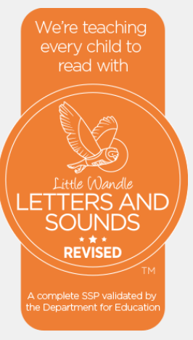
Phonics Curriculum Progression
Little Wandle Phonics
Curriculum Progression

Slide 2
Phonics Curriculum Progression
Phonics (reading and spelling)
At Peover Superior Primary School we believe that all our children can become fluent readers and writers. This is why we teach reading using Little Wandle Letters and Sounds Revised, which is a systematic and synthetic phonics programme. We start teaching phonics as soon as the children start school in Reception and follow the Little Wandle Letters and Sounds Revised progression, which ensures children build on their growing knowledge of the alphabetic code, mastering phonics to read and spell as they move through school.
As a result, all our children are able to tackle any unfamiliar words as they read. At Peover Superior Primary School, we also model the application of the alphabetic code through phonics in shared reading and writing, both inside and outside of the phonics lesson and across the curriculum. We have a strong focus on language development for our children because we know that speaking and listening are crucial skills for reading and writing in all subjects.

Slide 3
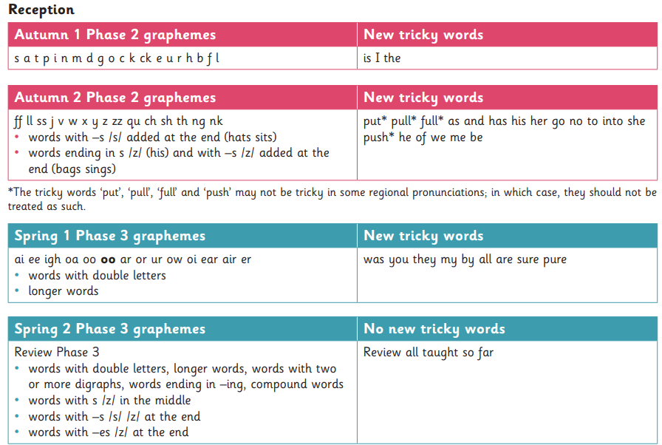
Phonics Curriculum Progression

Slide 4
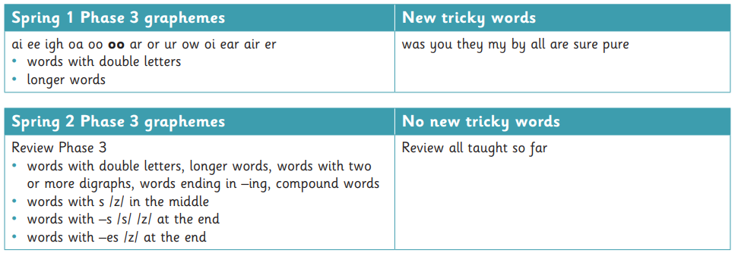
Phonics Curriculum Progression

Slide 5
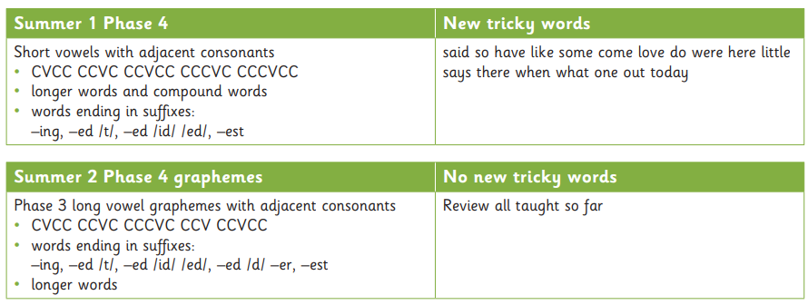
Phonics Curriculum Progression

Slide 6
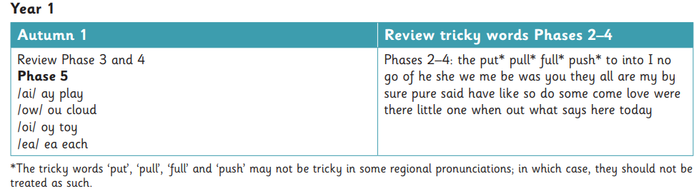
Phonics Curriculum Progression

Slide 7
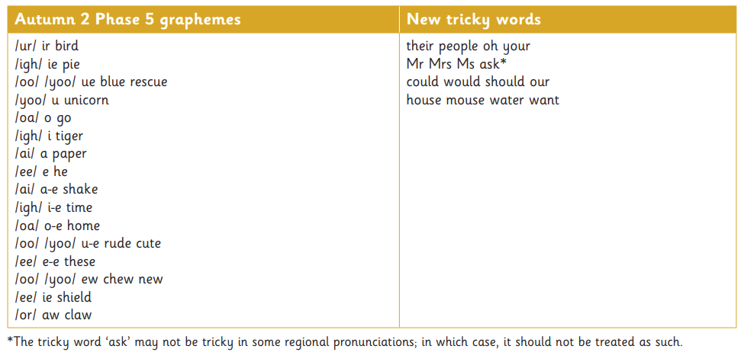
Phonics Curriculum Progression

Slide 8
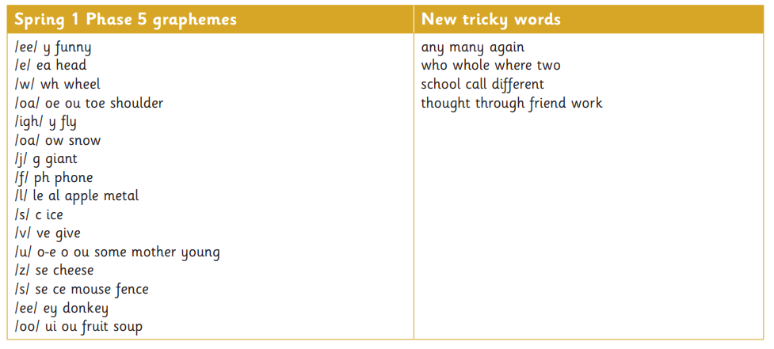
Phonics Curriculum Progression

Slide 9
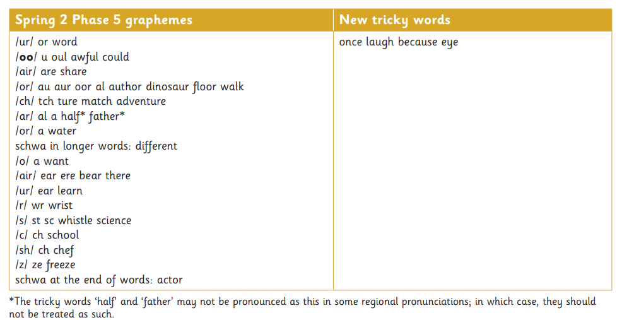
Phonics Curriculum Progression

Slide 10
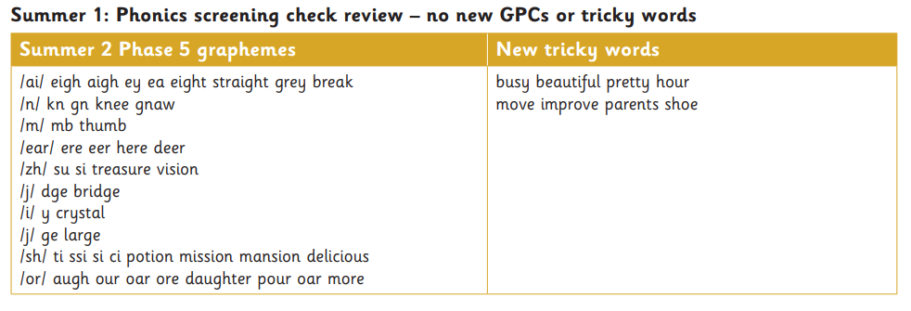
Phonics Curriculum Progression

Slide 11
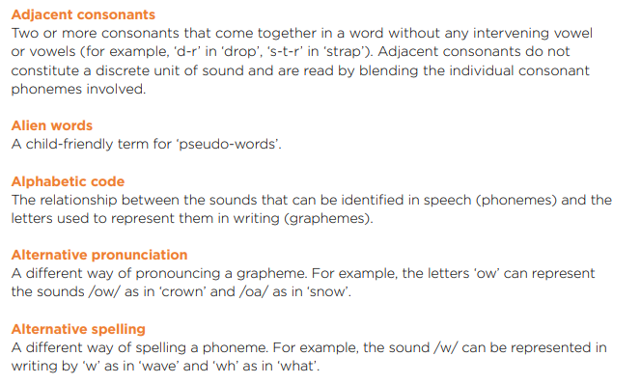
Glossary of Phonic Terminology

Slide 12
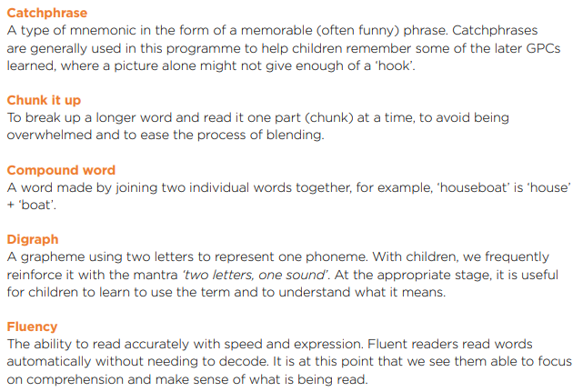
Glossary of Phonic Terminology

Slide 13
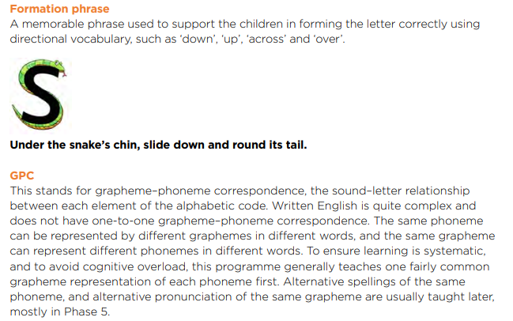
Glossary of Phonic Terminology

Slide 14
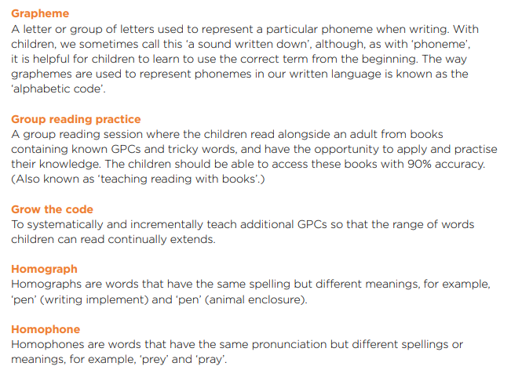
Glossary of Phonic Terminology

Slide 15
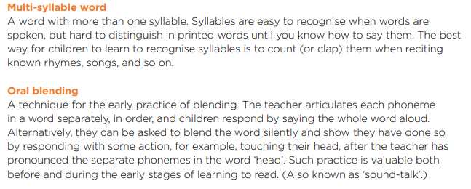
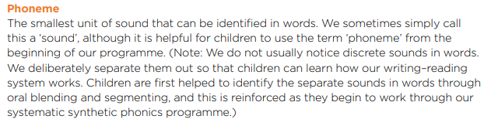
Glossary of Phonic Terminology

Slide 16
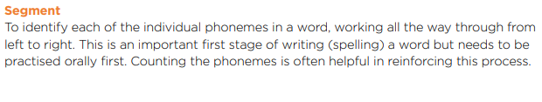
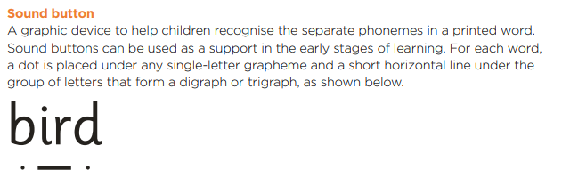

Glossary of Phonic Terminology

Slide 17
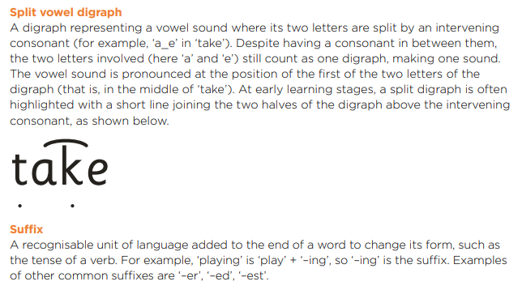
Glossary of Phonic Terminology

Slide 18
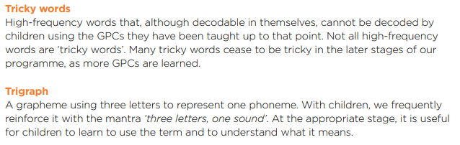

Glossary of Phonic Terminology

