Slide 1

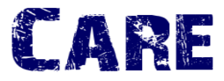
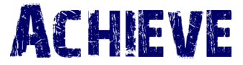
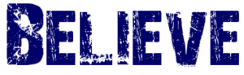
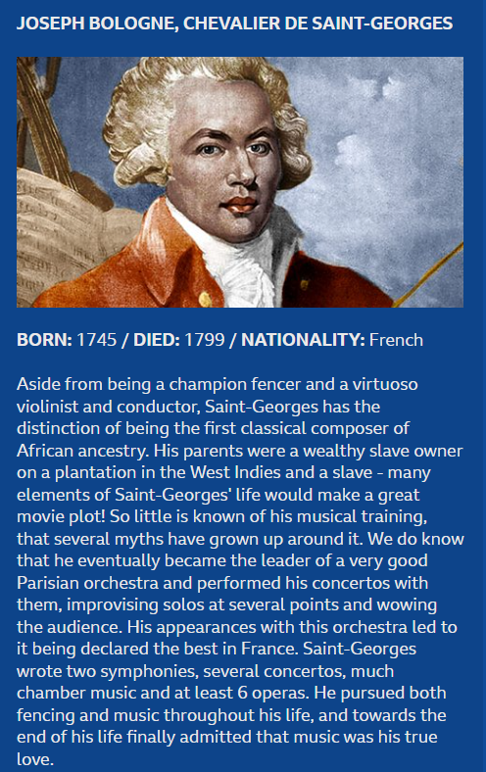


Composer of the Month
Joseph Bologne, Chevalier de Saint-Georges
https://www.bbc.co.uk/programmes/p05ggdyw

