Slide 1
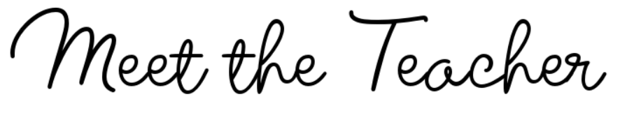


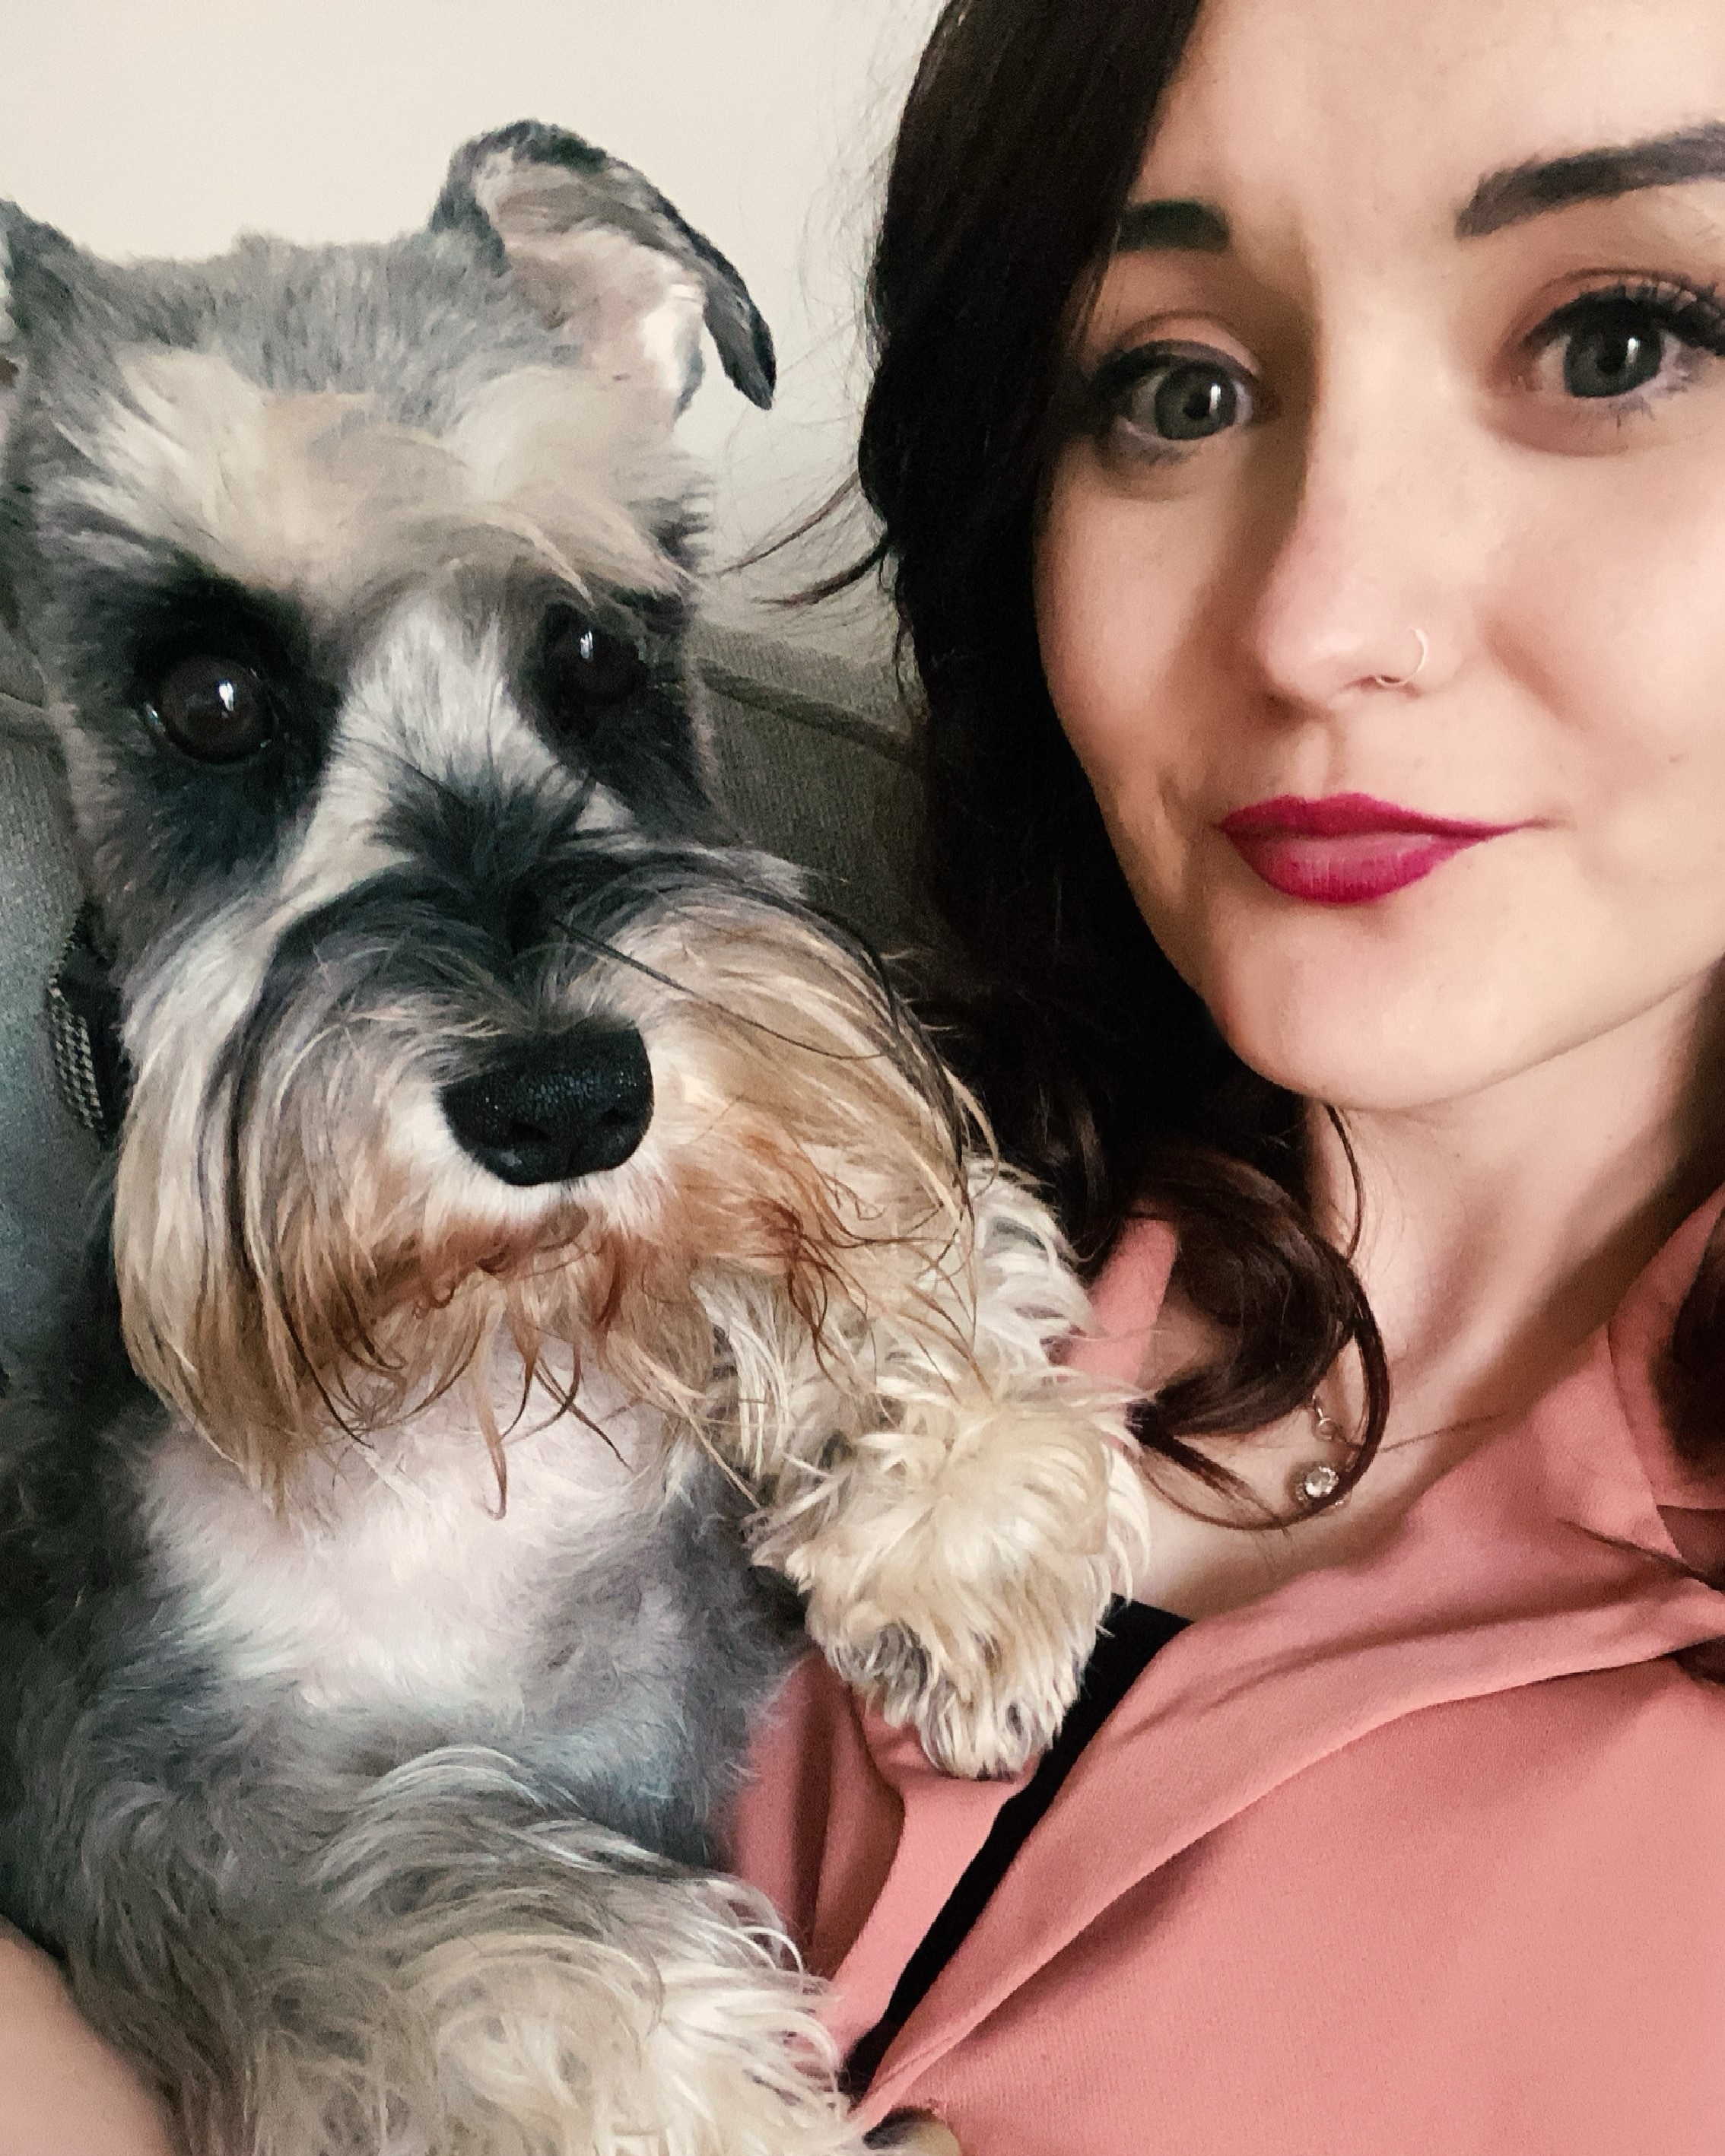

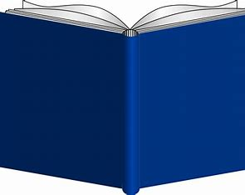
When I’m not at school, you can find me out in the countryside with my dog, Ozzy; with my nose inside a book or at the gym!
I also love experimenting in the kitchen and I am always trying to find new ways to recreate some of my favourite meals and cakes - but vegan!
Hobbies and Interests…
Hello Class 3!
I am so excited to be coming back to our small but mighty school this year to teach all you wonderful children! We have lots of amazing things planned this year and I can’t wait to share them with you all!
Welcome
Miss Downing – Class 3!
After reading Holes by Louie
Sachar myself when I was in
Year 6, I fell in love with it!
I love the strong characters
and the plot that keeps you
on the edge of
your seat. A
must read for
everyone!
My Favourite
children’s book and why…
Email: admin@peoversuperior. cheshire.sch.uk
Class Twitter Page: @Class3PS
Contact Information

